Slide 1
Single Working Parent
Tara Baker

Slide 2
Single Working Taxpayer
This lesson will focus on a tax return for a typical single parent taxpayer
The following new tax topics* will be discussed:
  Filing Status: Head Of Household (HOH)
  Dependency: Qualifying Child
  Income: Disability, Alimony, Gambling Winnings, and Cancellation of Debt
  Adjustments: Early Withdrawal Penalty
  Credits: Child Tax Credit, Child and Dependent Care Credit, and Earned Income Credit
Additional topics/practice on previously introduced forms:
  W-2: 401k Contributions, Private Plan Disability, Flexible Spending Accounts
  1099-INT: Taxable Interest, Early Withdrawal Penalty, Market Discount and Bond Premiums
  Form 8880 for Retirement Savings Credit
* This problem assumes that the Andrews problem has been completed already. Tax topics introduced
in Andrews may appear in Baker, but they will not be discussed again

Slide 3
Basic Information
Tara Baker

Slide 4
Scenario Step 0
Basic Information

Slide 5
Five Choices for Filing Status
Single
Married Filing Jointly (MFJ)
Married Filing Separately (MFS)
Head Of Household (HOH) – used for Baker problem
Qualified Widow(er) (QW)

Slide 6
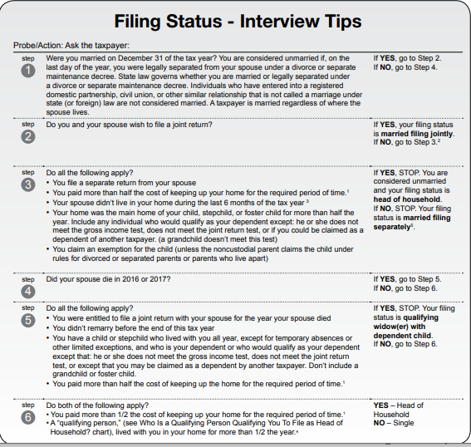
Filing Status: Interview Tips – Pub 4012 Page B-9
You can claim HOH
filing status if you
are married or
unmarried, but rules differ
HOH – Legally still married, but considered unmarried for filing status
HOH - Unmarried

Slide 7
Head of Household – Unmarried
You paid more than ½ the cost of keeping up your home in tax year AND
A “qualified person” lived with you for more than ½ the year
  “Qualified person” may be a qualifying child or a qualifying relative
    Pub 4012 Pages C-3 to C-5 provide more detail about qualifying child and qualifying relative (covered later)
    HOH rules differ for qualifying child vs. qualifying relative
    HOH rules differ depending on how the person is related to you
  Use chart on Pub 4012 Page B-10 to determine who is a qualifying person for HOH filing status
    Be very sure to check the footnotes when using all charts

Slide 8
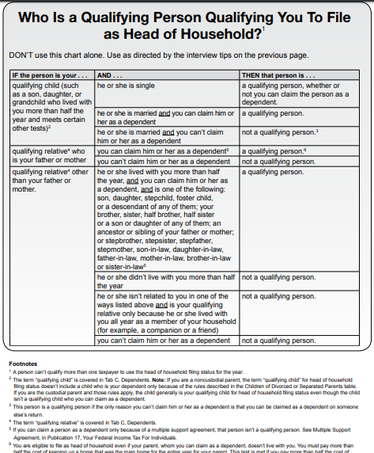
Qualifying Person for HOH – Pub 4012 Page B-10

Slide 9
Head of Household – Married
Lived apart from your spouse all of last 6 months of year
You filed a separate return from your spouse AND
You paid more than ½ the cost of keeping up your home in tax year AND
Home is main home for child, stepchild, or eligible foster child for more than ½ the year
  No other relatives qualify

Slide 10
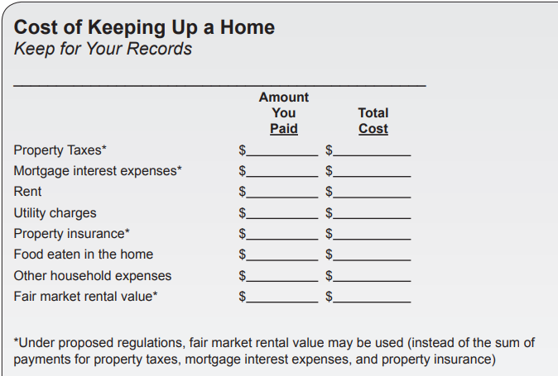
Cost of Keeping Up a Home – Pub 4012 Page B-11
Can itemize expenses
Rule change – may use rental Fair Market Value (FMV) instead of itemizing; may provide simpler computation

Slide 11
Filing Status: Head of Household - Advantages
Key advantages
  Higher standard deduction than Single or MFS
  Advantageous tax rate structure

Slide 12
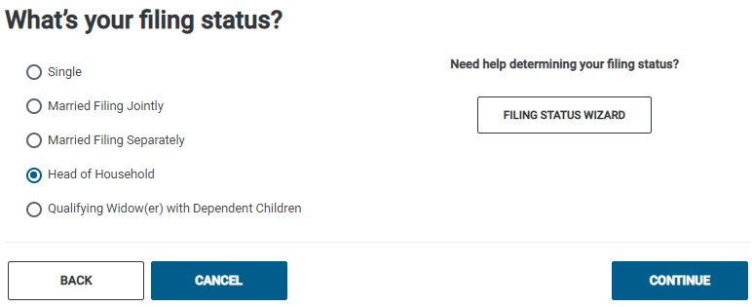
TSO – Entering Filing Status
Basic Information>Filing Status
Filing status
HOH filing status

Slide 13
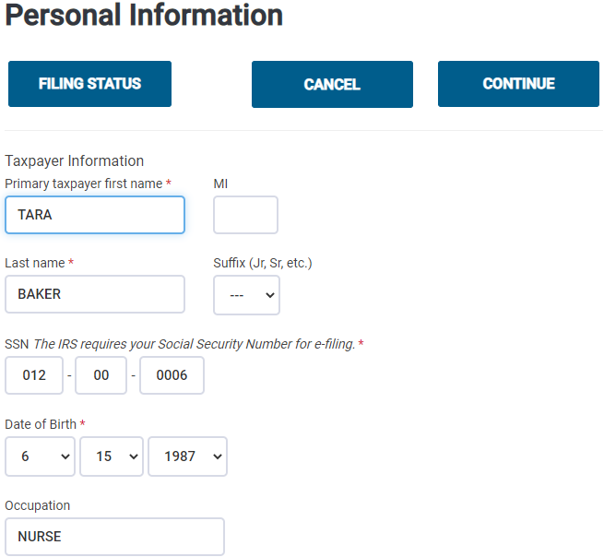
TSO – Entering Personal Information for Baker
Basic Information>Personal Information
See Andrews problem
for information on
completing Personal
Info screens

Slide 14
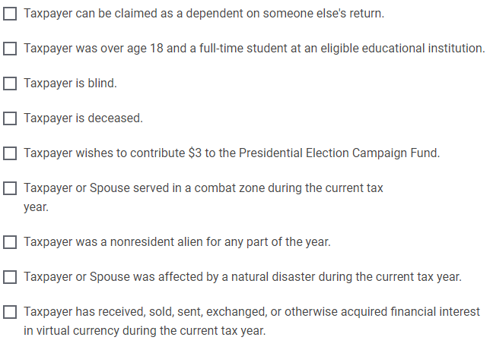
TSO – Entering Personal Information for Baker
Basic Information>Personal Information
cont’d
Check any boxes that apply

Slide 15
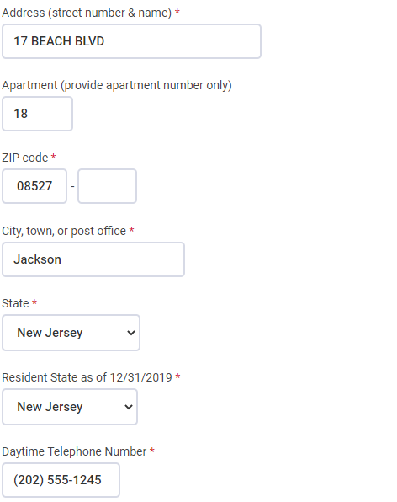
TSO – Entering Personal Information for Taxpayer
Basic Information>Personal Information
cont’d
Apartment number

Slide 16
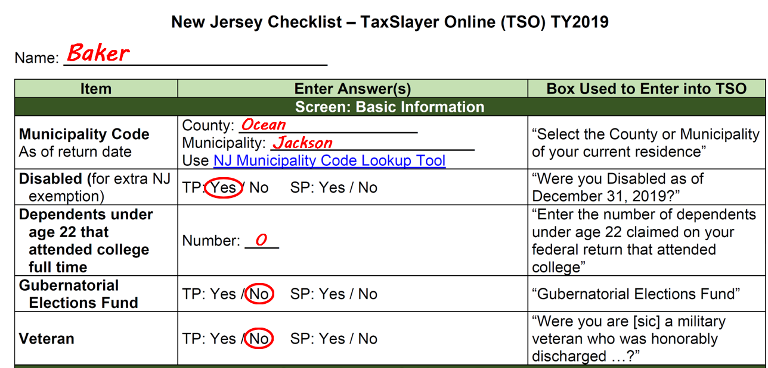
Enter Additional Personal Info on NJ Checklist

Slide 17
Dependent Exemption
Person other than taxpayer or spouse who entitles taxpayer to an exemption:
  Qualifying child (which also includes adult with disability)
  OR
  Qualifying relative (which also includes qualifying non-relatives)
For this lesson only Qualifying Child will be discussed

Slide 18
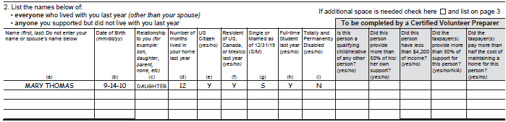
Using Intake Sheet and Interview to Determine Dependents
Ask: Who else lived with you?
Who else did you support?
Counselors are required to determine the answers to all questions in the shaded boxes and record them on the Intake Sheet
All this information will be used to determine who can be claimed as a dependent

Slide 19
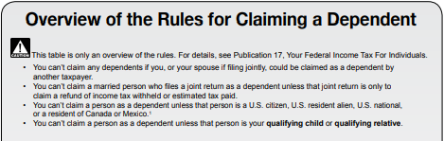
Overview of Rules for Claiming a Dependent –
Pub 4012 Page C-1

Slide 20
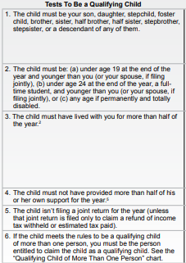
Tests to be a Qualifying Child – Pub 4012 Page C-1
Be sure to read the
footnotes
Relationship test
Age test
Residency test
Support test
Joint return test
Can be claimed by more than
1 person

Slide 21
Qualifying Child – Definition of Terms
Permanently and totally disabled
  Person cannot engage in any substantial gainful activity because of a physical or mental condition AND
  Doctor determines condition has lasted or can be expected to last continuously for at least a year or can lead to death
  Volunteers are not required to see documentation; however, the taxpayer needs to understand that a physician certification is required

Slide 22
Qualifying Child – Definition of Terms cont’d
Student
  A full-time student during some part of each of any five calendar months of the year
  Full-time is the number of hours or courses the school considers to be full-time
  Attending a school that has a regular teaching staff, course of study and student body at the school

Slide 23
Qualifying Child – Definition of Terms cont’d
Temporary absence
  Circumstances such as illness, education, business, vacation, military service
    Now also includes: Incarceration and Institutionalized care for a child who is permanently and totally disabled
  Must be reasonable to assume the absent person will return
  Must continue to keep up the home during the absence

Slide 24
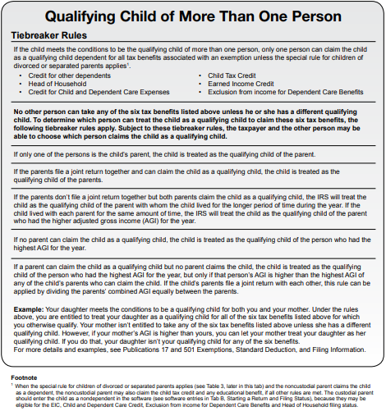
Qualifying Child of More than One Person
(Tiebreaker Rules) – Pub 4012 Page C-2

Slide 25
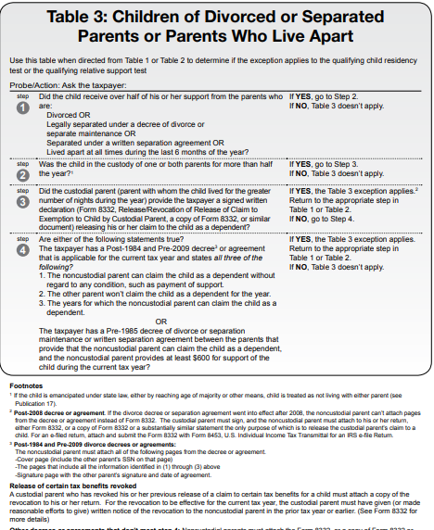
Children of Divorced or Separated Parents – Pub 4012 Page C-6

Slide 26
Tools for Determining Dependency
Pub 4012 Tab C (previously discussed)
Laminated flowchart “Qualifying Child/Qualifying Relative” – each counselor receives their own copy
  Online version of flowchart on TP4F Preparer page
IRS Interactive Tax Assistant – TP4F Preparer page link
Bogart Dependent Calculator – TP4F Preparer page link

Slide 27
Laminated Flowchart “Qualifying Child/
Qualifying Relative”

Slide 28
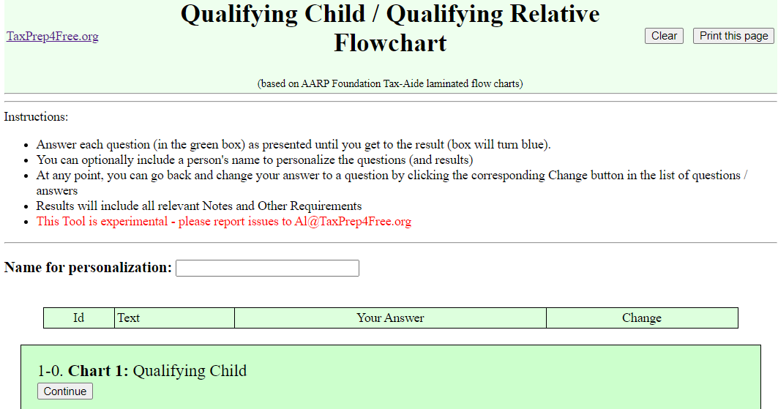
Online Version of Laminated Flowchart “Qualifying Child/ Qualifying Relative”
TP4F Preparer Page

Slide 29
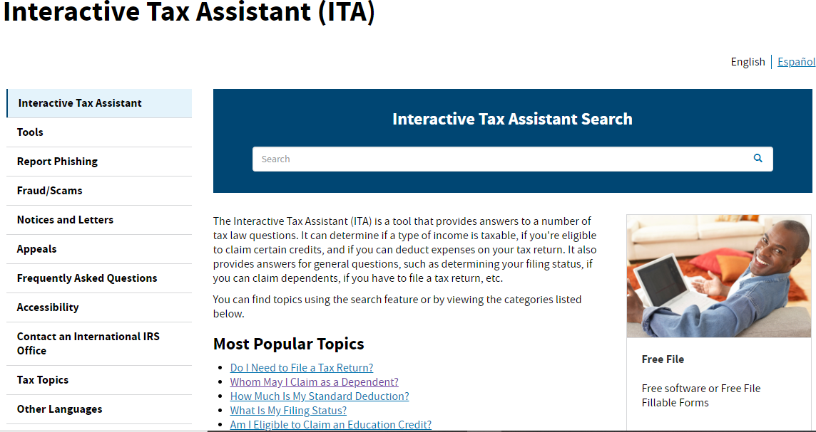
IRS Interactive Tax Assistant
TP4F Preparer page > IRS Links
Dependency tool

Slide 30
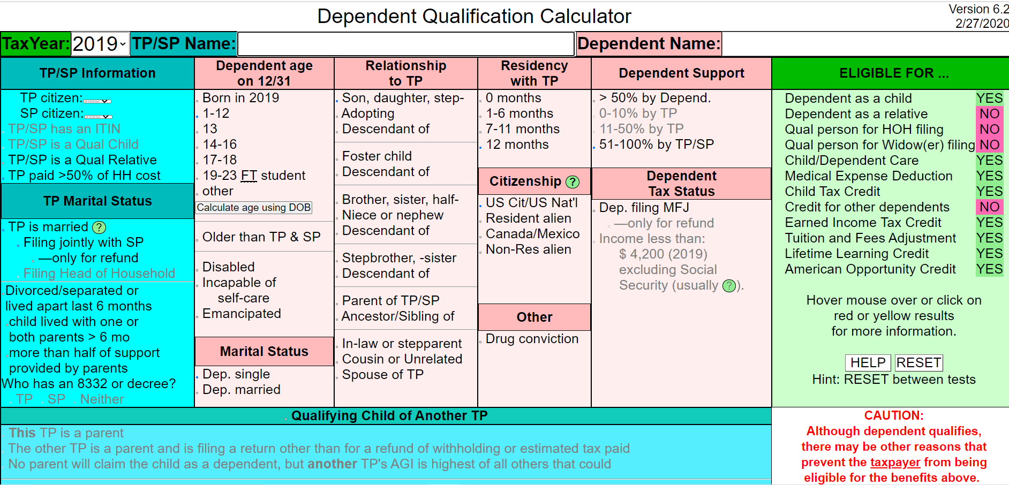
Bogart Dependent Calculator
TP4F Preparer Page > Jeff Bogart’s Toolbox

Slide 31
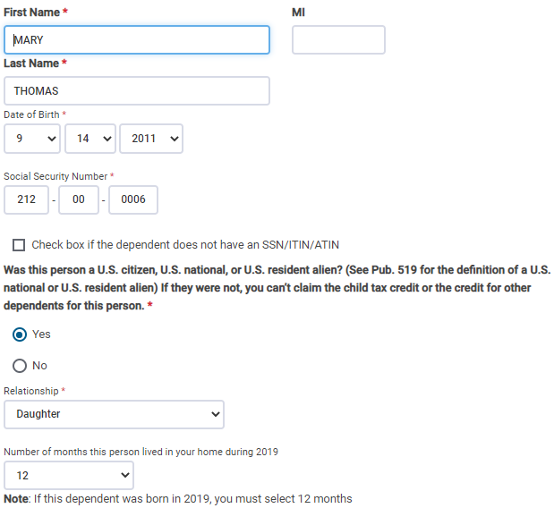
TSO – Entering Dependent Information
Basic Information>Dependents/Qualifying Persons
TSO populates based on taxpayer’s last name; Correct if needed
Date of birth
Social Security #
Citizenship status
Relationship to taxpayer
Months in home; enter 12 if born/died in tax year

Slide 32
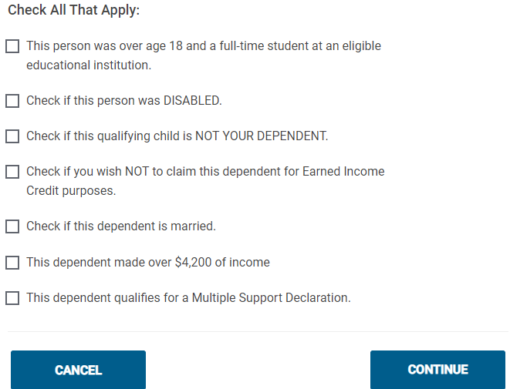
TSO – Entering Dependent Information
Basic Information>Dependents/Qualifying Persons
cont’d
Check all that apply

Slide 33
TSO - Student Activity
Basic Information>Filing Status, Personal and Dependent Information
Pause the slide show
Enter the Baker Filing Status as well as the Personal and Dependent information into TSO (Step 0)

Slide 34
Income
Tara Baker

Slide 35
Scenario Step 1
W-2 Baptist Medical Center

Slide 36
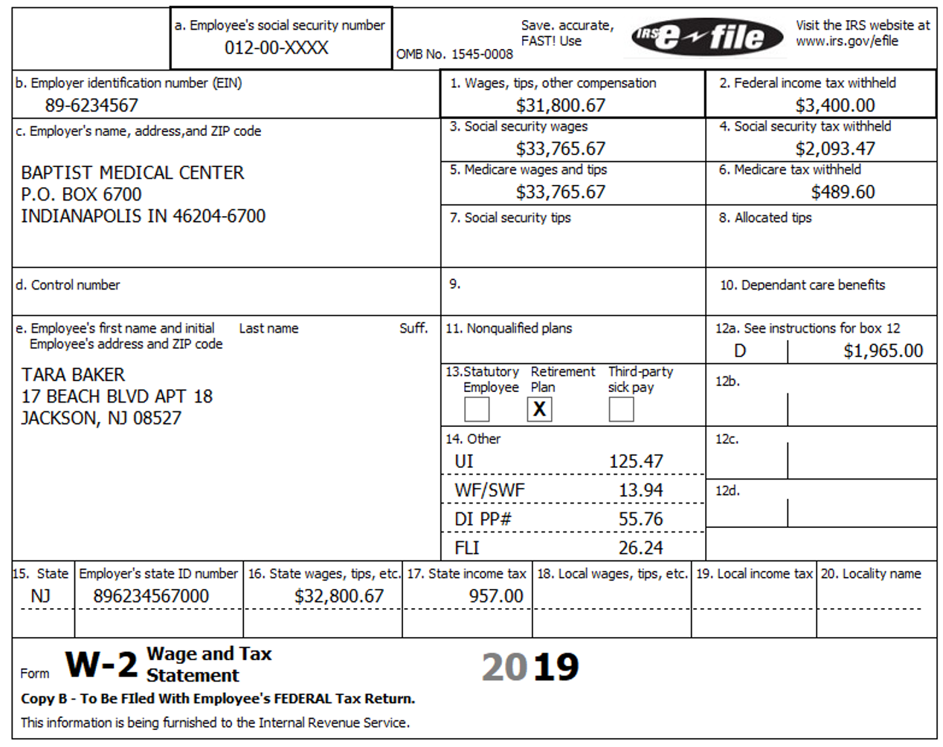
Form W-2
Difference between Box 1
wages and Boxes 3/5 wages
Retirement plan
checked
Code D – 401k contribution
Private plan disability
Difference between Federal
and NJ wages

Slide 37
Information on Baker W-2 Not on Andrews W-2
See Andrews problem for basic W-2 information
Difference between Box 1 wages and Boxes 3/5 wages
  Due to contribution to 401k, shown in Box 12a with code D
  Pre-tax contribution, so amount not included in Box 1 taxable wages, but is included in Social Security and Medicare wages
  401k contribution is also pre-tax for NJ
    No NJ Checklist entry needed since no difference between Federal and NJ
  401k contribution qualifies for Retirement Savings Credit
    TSO automatically creates Form 8880 to calculate credit
Box 13 – Retirement plan is checked
  Information used for Traditional IRA deduction

Slide 38
New Information on Baker W-2 cont’d
Box 14 - Private plan disability (PP#)
  Refer to NJ Special Handling document under W-2 section
  Employer offers private plan instead of State disability plan
  Private plan withholdings cannot be claimed as itemized deduction on Schedule A (as State disability withholdings can)
    TSO automatically transfers amounts entered as NJSDI to Schedule A
    If taxpayer is itemizing, enter private plan amount as a negative number on Itemized Deduction>Taxes You Paid screen to subtract from state taxes paid itemized deduction
  Private plan # is entered on NJ Checklist in Payments section

Slide 39
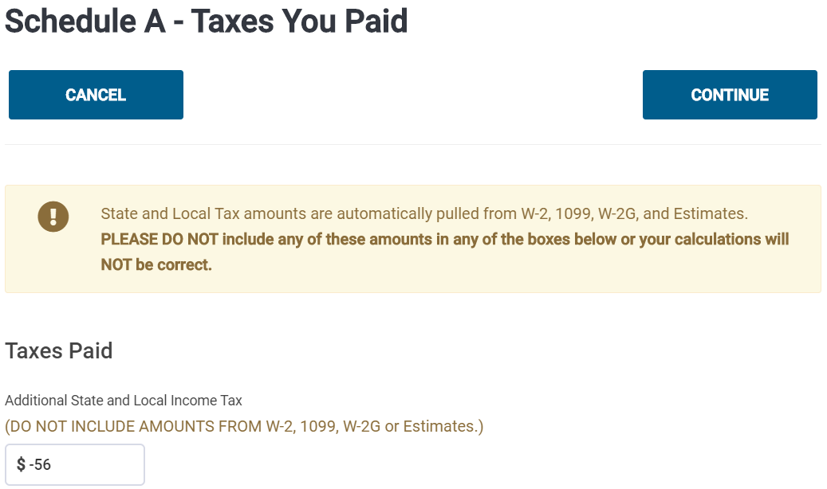
TSO – Entering Private Plan Disability on Schedule A
Federal section>Deductions>Itemized Deductions>Taxes You Paid>Additional State and Local Income Tax
WARNING: If TSO gives you a
message, “A value in one of
these fields or a Sales Tax Work-
sheet is required,” just enter 0 on
each line with that message
Private Plan
disability – to
subtract from
itemized deductions
on Schedule A
Enter as a negative amount

Slide 40
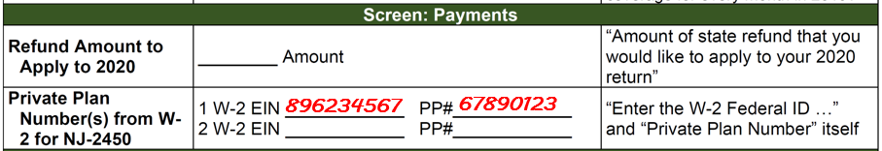
Private Plan # on NJ Checklist
Private Plan #
EIN from appropriate W-2

Slide 41
Information on Baker W-2 Not on Andrews W-2 cont’d
Difference between Federal wages (Box 1) and NJ wages (Box 16)
  Due to funding of Flexible Spending Account (FSA) mentioned in interview
    Must confirm with taxpayer that this is the reason for difference
    Frequently shown on end-of-year pay stub
  FSA funding amount is pre-tax for Federal (not included in Box 1 wages)
    Cannot also claim tax benefit by including in Schedule A medical expenses

Slide 42
Information on Baker W-2 Not on Andrews W-2 cont’d
Difference between Federal wages (Box 1) and NJ wages (Box 16) – cont’d
  FSA funding amount is after-tax for NJ (included in Box 16 wages)
    Since no NJ tax benefit for funding of FSA, amount of FSA actually used for medical expenses can be claimed as medical expenses on NJ 1040 (not amount contributed to FSA)
    Note actual medical expenses paid out of FSA on NJ Checklist in Subtractions from Income section to add to NJ medical deduction
    Refer to NJ Special Handling document

Slide 43
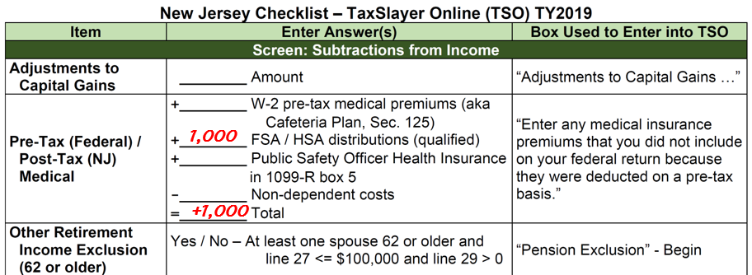
Medical Expenses Paid From FSA on NJ Checklist
Medical expenses
paid out of FSA

Slide 44
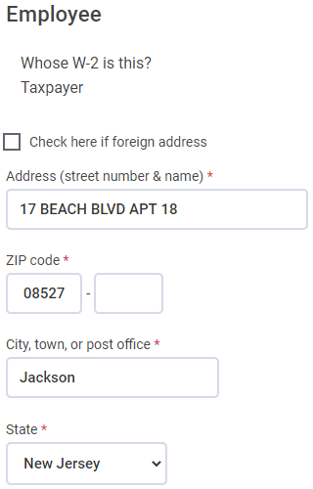
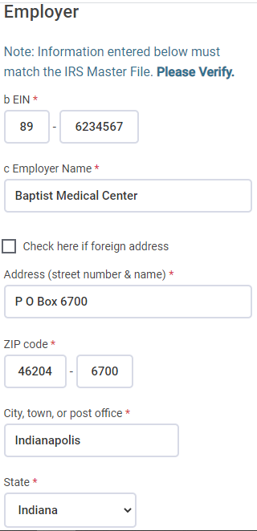
TSO - Entering W-2
Federal Section>Income>W-2
Employee
Information
Employer
Information

Slide 45
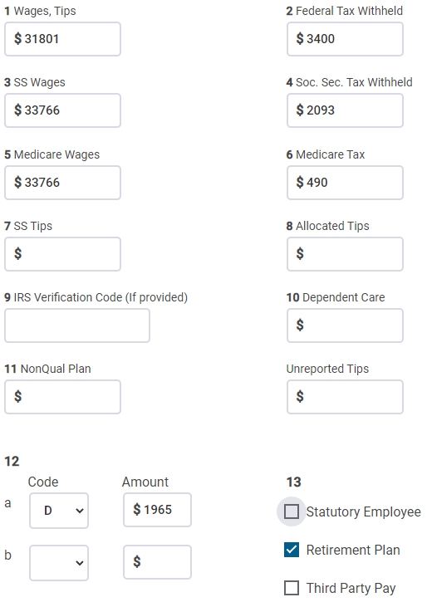
TSO - Entering W-2
Federal Section>Income>W-2
cont’d
TSO populates Boxes 3 and 5 based
on Box 1; Correct to match printed
W-2; TSO recalculates Boxes
4 and 6
Choose code D
from drop-down
menu
C
Retirement Plan checked

Slide 46
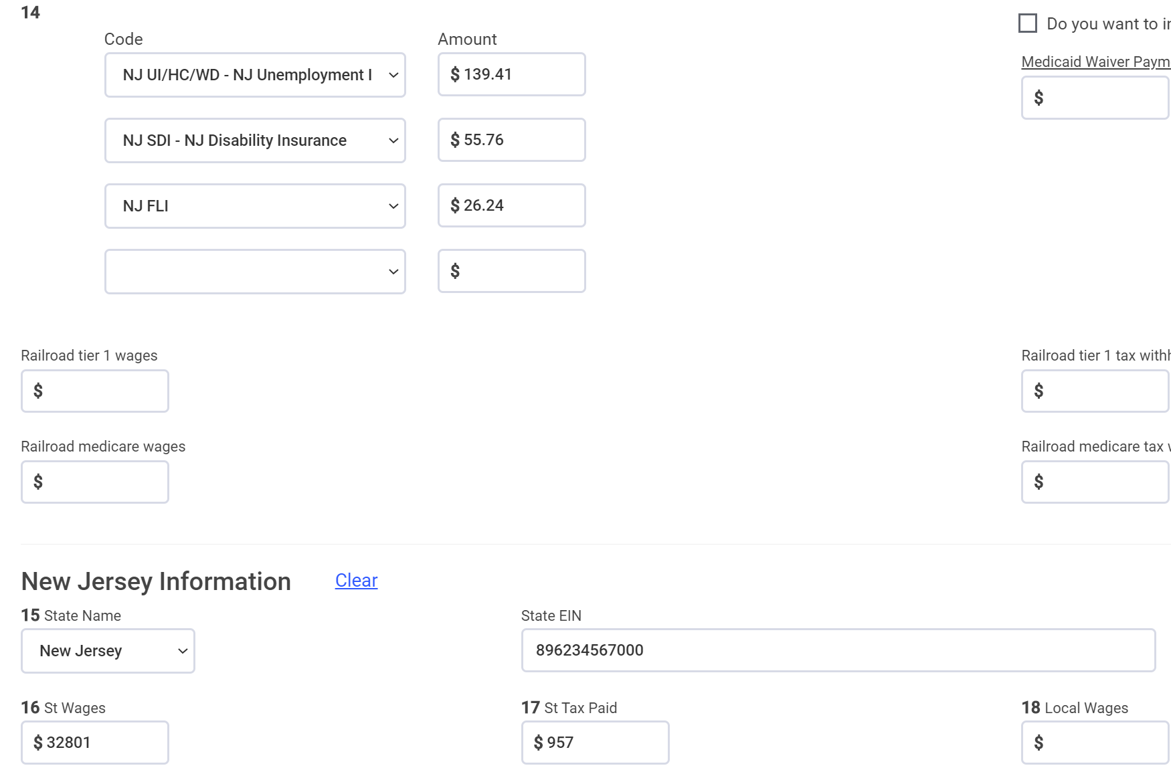
TSO - Entering W-2
Federal Section>Income>W-2
cont’d
Choose NJSDI from drop-
down menu for Private Plan disability
TSO transfers from Box 1;
Correct to match printed
W-2

Slide 47
TSO - Student Activity
Federal Section>Income>W-2
Pause the slide show
Enter the Baptist Medical Center W-2 into TSO (Step 1)
  Remember to also subtract out the Private Plan disability amount from Itemized Deductions on the Taxes You Paid screen
    WARNING: If TSO gives you a message, “A value in one of these fields or a Sales Tax Worksheet is required,” just enter 0 on each line with that message
Check the Federal and NJ refund monitors

Slide 48
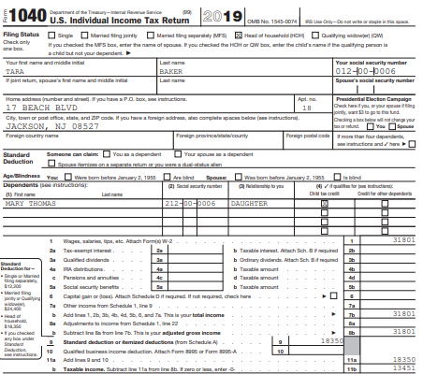
TSO - Wages on Federal 1040
Transferred from W-2
Box 1

Slide 49
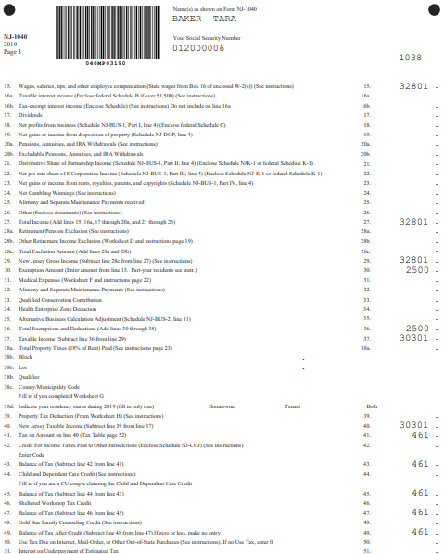
TSO - Wages on NJ 1040
Transferred from W-2
Box 16

Slide 50
Scenario Step 2
Interest

Slide 51
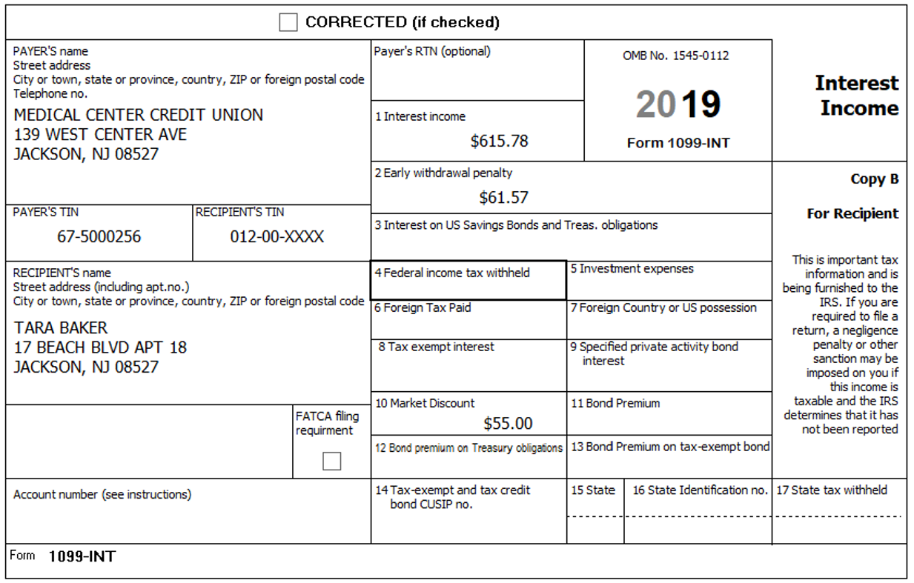
1099-INT
Taxable interest
Early withdrawal penalty
Market discount
and bond premiums

Slide 52
Information on Baker 1099-INT Not on Andrews 1099-INT
Refer to Pub 4012 Page D-8
Box 1 – Taxable interest
  Taxable on both Federal and NJ returns
  Enter on Federal Interest screen and TSO transfers to NJ taxable interest
Box 2 – Early withdrawal penalty
  Interest or principal forfeited because of early withdrawal of time savings (e.g. – certificate of deposit)
  Included in taxable interest for Federal, but can be offset by claiming an adjustment on Federal 1040 Schedule 1 Line 17
    TSO automatically generates the adjustment

Slide 53
Information on Baker 1099-INT Not on Andrews 1099-INT cont’d
Box 2 – Early withdrawal penalty – cont’d
  Not included in NJ taxable interest
    Refer to NJ Special Handling document
    TSO automatically handles
    No need for NJ Checklist entry
Box 10 - Market discount (when you pay less for a bond than redemption value)
  TSO automatically adds to Box 1 taxable interest
Box 11 – Bond premium (when you pay more for a bond than redemption value)
  TSO automatically subtracts from Box 1 taxable interest
  Out of scope if greater than amount in Box 1 (see Pub 4012 Page D-9)

Slide 54
Information on Baker 1099-INT Not on Andrews 1099-INT
cont’d
Box 12 – Bond premium on Treasury obligations
  TSO automatically subtracts from Box 3 interest on savings bonds and Treasury obligations
  Since U.S. obligations are not taxable for NJ, must subtract Box 3 minus Box 12 when you tell TSO “Amount of interest on US Savings Bonds or Treasury Obligations that you want subtracted from your State return”
Box 13 – Bond premium on tax-exempt bond
  If there is an amount in Box 13, TSO does not handle automatically
  Subtract Box 13 from tax-exempt interest in Box 8 and enter result in Box 8 (see 4012 D-9)

Slide 55
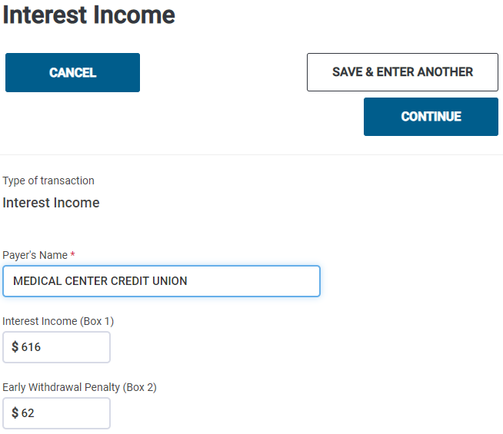
TSO – Entering 1099-INT
Federal Section>Income>1099-DIV,INT,OID>Interest or Dividend Income>Interest Income, Form1099-INT
Taxable income
Early withdrawal penalty

Slide 56
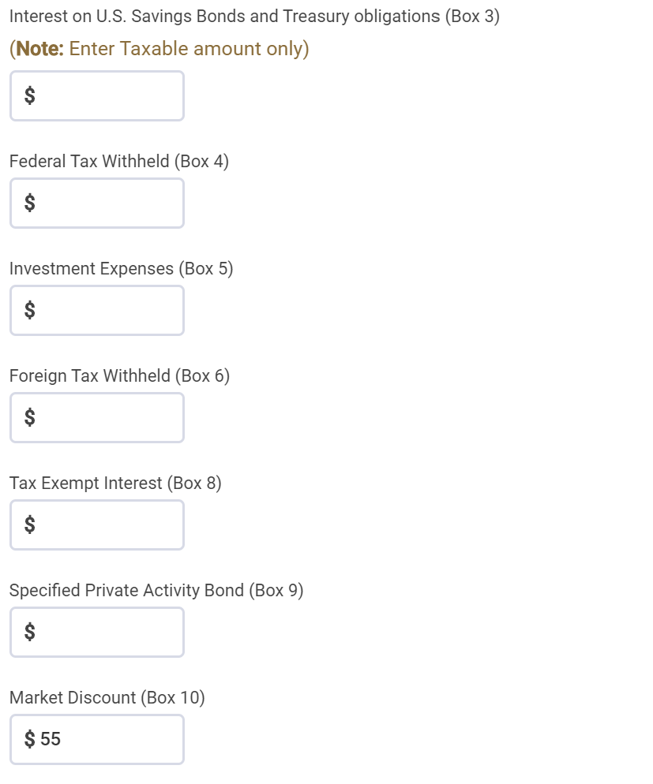
TSO Entering - Entering 1099-INT
Federal Section>Income>1099-DIV,INT,OID>Interest or Dividend Income>Interest Income, Form1099-INT
cont’d
Market discount

Slide 57
TSO - Student Activity
Federal Section>Income>1099-DIV,INT,OID>Interest or Dividend Income>Interest Income, Form1099-INT
Pause the slide show
Enter the Medical Center Credit Union Interest into TSO (Step 2)
Check the Federal and NJ refund monitors

Slide 58
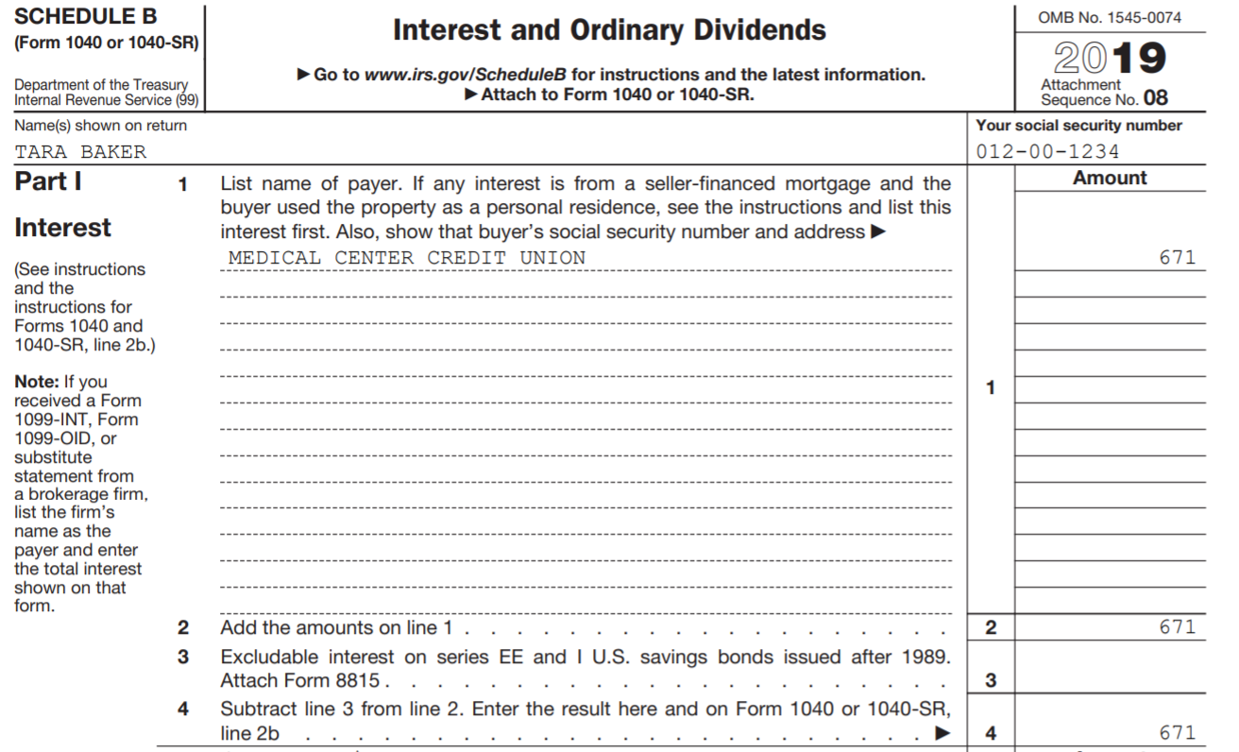
TSO – Taxable Interest on Federal Schedule B
Total interest =
taxable interest ($616)
+ market discount ($55)

Slide 59
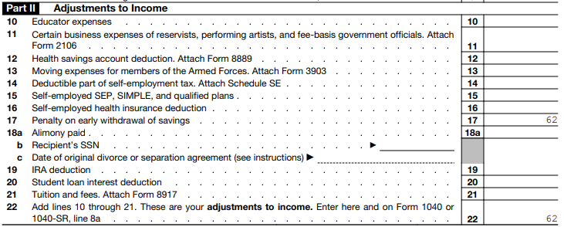
TSO – Early Withdrawal Penalty on Federal Schedule 1, Part II
Transferred from 1099-INT
Box 2
Taxable Interest on Schedule B
Total of all Adjustments to
Income

Slide 60
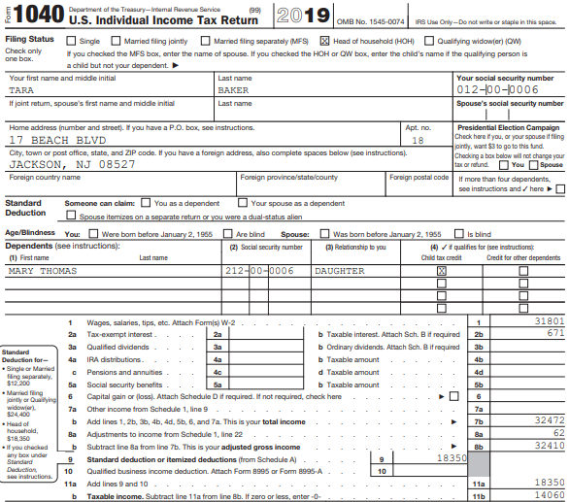
TSO – Taxable Interest on Federal 1040
Transferred from Schedule B

Slide 61
TSO – Early Withdrawal Penalty on Federal 1040
Transferred from Schedule 1,
Part II, total

Slide 62

TSO – Taxable Interest on NJ 1040
Box 1 interest $616
Box 2 early W/D penalty - 62
Box 10 market discount + 55
NJ Total $609

Slide 63
Scenario Step 3
Disability Pension

Slide 64
IRA Distribution – 1099-R Box 7 Codes
Review Pub 4012 Page D-39 for 1099-R distribution codes
Most commonly seen:
  1 – Early Distribution
  3 – Disability – Baker problem
  4 – Death
  7 – Normal Distribution – most commonly seen
  G - Rollover
Always check the Tax-Aide Scope Manual if unsure whether 1099-R is in scope

Slide 65
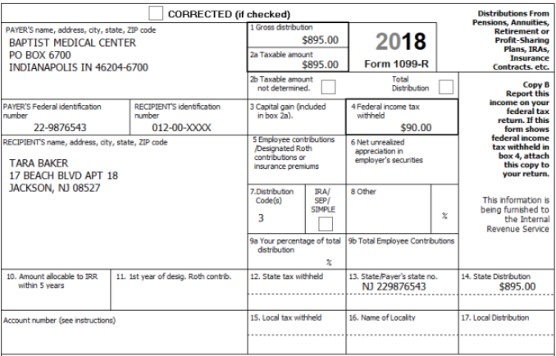
Disability Pension on 1099-R
Gross distribution
Taxable distribution
Federal taxes withheld
Code 3 indicates
disability pension

Slide 66
Disability Pension on 1099-R
Refer to Pub 4012 Page D-37
Reported on Form 1099-R with a Code 3 in Box 7
Until taxpayer reaches employer’s minimum retirement age
  Disability payments taxed as wages on Federal return
  Reported on Federal 1040 Line 1
  Since reported as wages, can be counted for Earned Income Credit, Additional Child Tax Credit, Dependent Care Credit
  Must ask taxpayer what employer’s minimum retirement age is

Slide 67
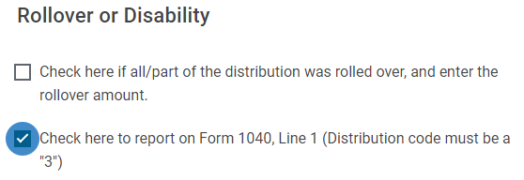
Disability Income on 1099-R cont’d
  Check the box near the bottom of the 1099-R input screen to tell TSO that disability should be reported as wages
Once employer’s minimum retirement age is reached
  Disability income taxed as pension
  Reported on 1040 Line 4d

Slide 68
Disability Pension on NJ Return
Refer to NJ Special Handling document
If recipient of disability pension is under age 65, NJ does not tax the disability income
  TSO automatically transfers taxable amount of disability pension to NJ
  Note taxable amount on NJ Checklist in Income Subject to Tax section as an Adjustment to Line 20a – Taxable Amount of IRAs, Pensions and Annuities
  Enter as a negative amount to subtract from NJ income
Starting year taxpayer turns 65, NJ taxes disability income as ordinary pension income
  TSO automatically transfers taxable amount to NJ

Slide 69
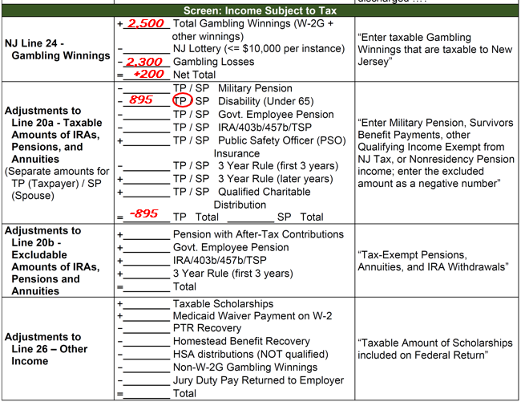
Disability Pension Under Age 65 on NJ Checklist

Slide 70
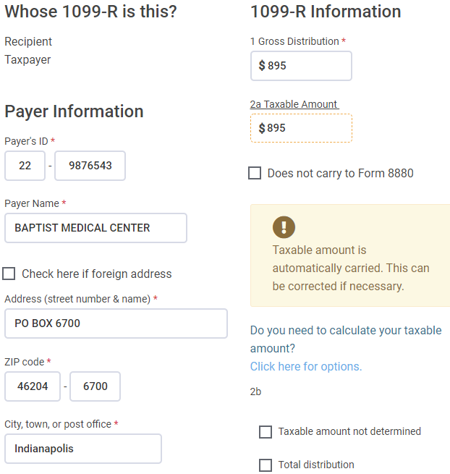
TSO – Entering Disability Pension on 1099-R Screen
Federal Section>Income>1099-R>Add or Edit a 1099-R
Gross amount of disability pension
Taxable amount of disability pension;
TSO populates based on Box 1;
Correct if needed

Slide 71
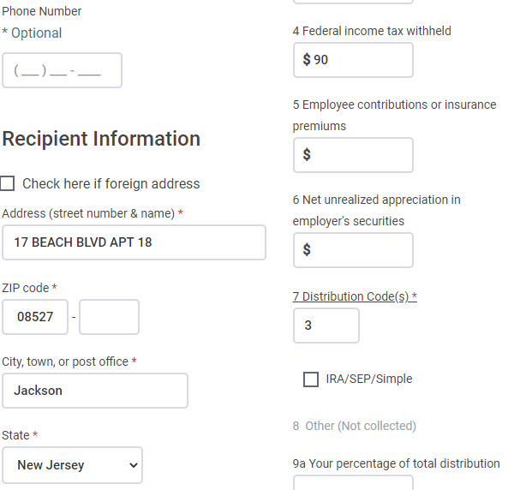
TSO – Entering Disability Pension on 1099-R Screen
Federal Section>Income>1099-R>Add or Edit a 1099-R
cont’d
Federal tax withheld
Code 3 indicates disability pension

Slide 72
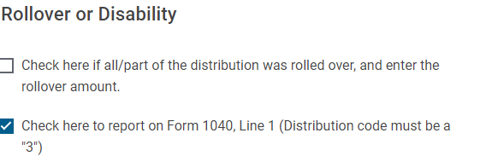
TSO – Entering Disability Pension on 1099-R Screen
Federal Section>Income>1099-R>Add or Edit a 1099-R
cont’d
Check to tell TSO to report disability
pension as wages

Slide 73
TSO - Student Activity
Federal Section>Income>1099-R>Add or Edit a 1099-R
Pause the slide show
Enter the Baptist Medical Center disability pension 1099-R into TSO (Step 3)
Check the Federal and NJ refund monitors

Slide 74
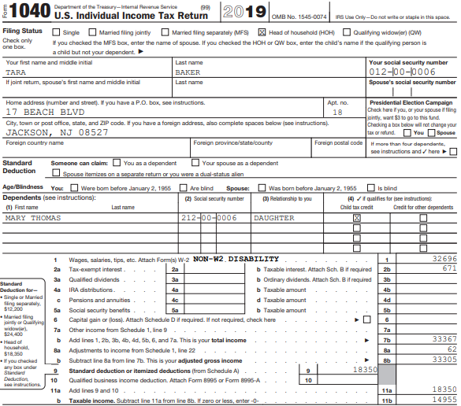
Disability Income Reported as Wages on Federal 1040
Includes W-2 wages ($31,801)
+ disability pension ($895)

Slide 75
Scenario Step 4
Alimony

Slide 76
Alimony Received
What is Alimony?
  Spousal support under separation or divorce document
  Usually stops if recipient remarries; may stop sooner
  Not subject to change based on factors such as age of a child
    Child support is NOT alimony
      Child support is not reported on tax returns at all
  Refer to Pub 4012 Page E-8 for more details

Slide 77
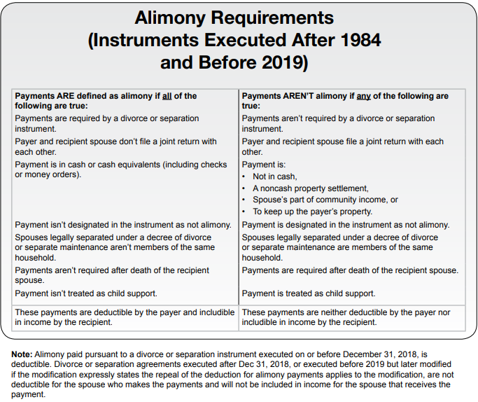
Alimony – Pub 4012 Page E-8

Slide 78
Alimony Received
cont’d
Where do I get information about alimony received?
Intake/Interview Sheet Part III Question 6
Taxpayer needs to provide actual amount received in the current tax year

Slide 79
Alimony Paid
Where do I get information on alimony paid?
Intake/Interview Sheet Part IV Question 1
Taxpayer needs to provide actual amount paid in the current tax year and Social Security # of recipient

Slide 80
Federal Tax Law Change Regarding Alimony
Divorce agreement executed prior to 1/1/2019
  Person receiving alimony must claim as income
  Person paying alimony can receive adjustment to income deduction
Divorce agreement executed/modified as of 1/1/2019 or later
  Person receiving alimony does not have to claim as income
  Person paying alimony does not receive adjustment to income deduction
  If modification, must specifically state it will be under new rules

Slide 81
Impact of Alimony Received on Credits/Adjustments
Not earned income for Earned Income Credit
Not earned income for Additional Child Tax Credit
Not earned income for Dependent Care Credit
But taxable alimony IS “compensation” for deduction for IRA Contributions

Slide 82
Alimony on NJ Return
Refer to NJ Special Handling document
Alimony received must be reported as income on NJ return, regardless of date of divorce
Alimony paid can be claimed as an adjustment to income on NJ return, regardless of date of divorce
TSO handles automatically; no need for NJ Checklist entry

Slide 83
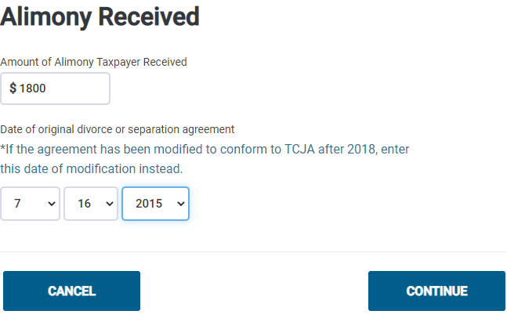
TSO – Entering Alimony Received
Federal Section>Income>Alimony Received
Alimony received
Determines whether alimony
received has to be claimed as income

Slide 84
TSO - Student Activity
Federal Section>Income>Alimony Received
Pause the slide show
Enter the alimony Baker received into TSO (Step 4)
Check the Federal and NJ refund monitors

Slide 85
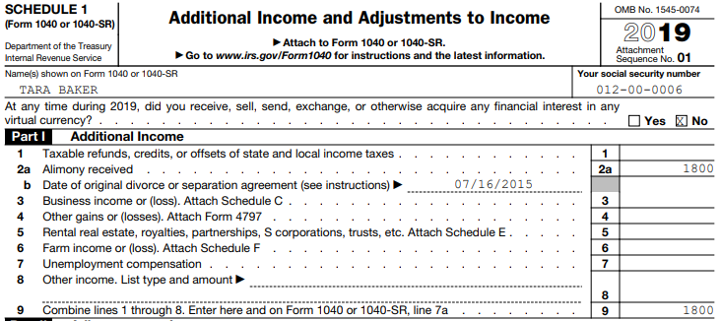
Alimony Received on Schedule 1, Part I
Date of divorce
Alimony received
Total of all Additional
Income

Slide 86
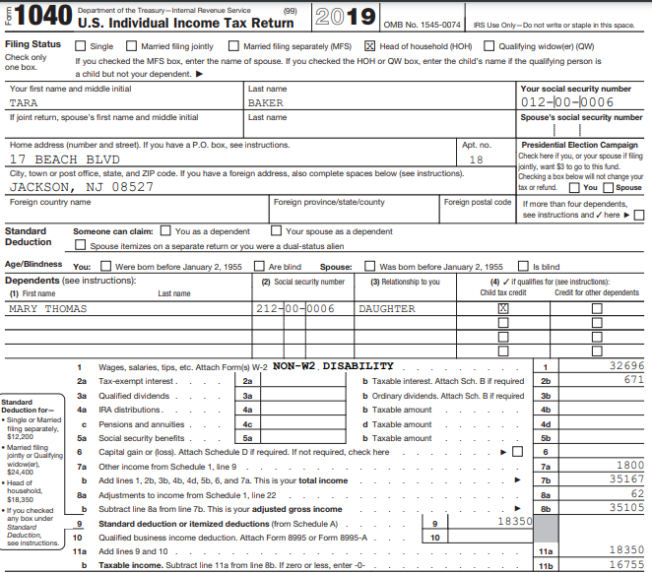
Alimony Received on Federal 1040
Transferred from Schedule 1, Part I, total

Slide 87
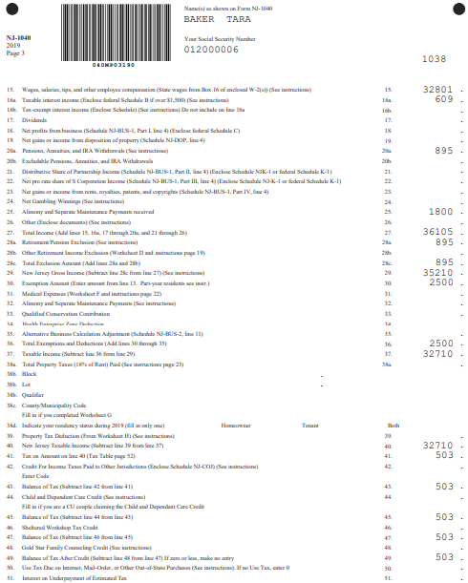
Alimony Received on NJ 1040
Alimony received

Slide 88
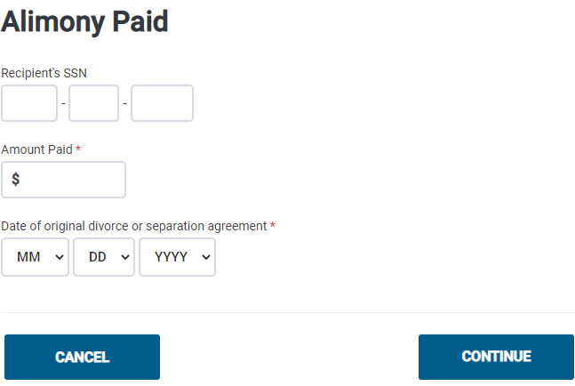
TSO – Entering Alimony Paid (not in Baker)
Federal Section>Deductions>Adjustments>Alimony Paid
Recipient’s SS #
Alimony paid
Determines whether alimony
paid can be claimed as adjustment
to income

Slide 89
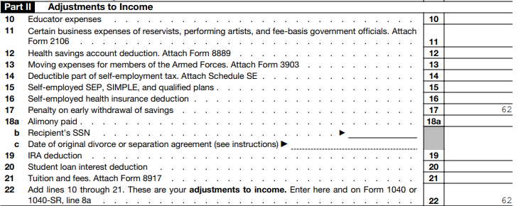
Alimony Paid on Schedule 1, Part II (not in Baker)
Alimony paid
Recipient’s SS #
Date of divorce

Slide 90
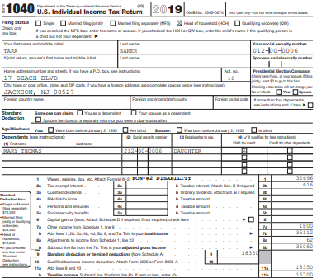
Alimony Paid on Federal 1040 (not in Baker)
Total Adjustments from
Schedule 1, Part II

Slide 91
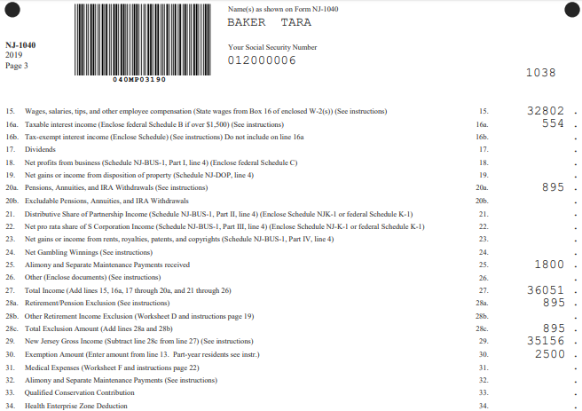
Alimony Paid on NJ 1040 (not in Baker)
Alimony paid

Slide 92
Scenario Step 5
Gambling Winnings

Slide 93
Other Income
Covers a variety of income other than wages, retirement, and investment income
Refer to Pub 4012 Page D-51
Examples include:
  Nonemployee compensation reported on 1099-MISC, Box 3
  Other income reported on 1099-MISC, Box 7
  Gambling winnings (including lotteries and raffles) reported on W-2G
  Taxable amount of long-term care payments reported on 1099-LTC
  Cancellation of debt reported on 1099-C

Slide 94

Other Income – Pub 4012 Page D-51
Types of Other Income covered in Baker:
Gambling winnings
Cancellation of debt

Slide 95

Gambling Winnings on W-2G
Gross winnings
Date won
Type of wager

Slide 96
Gambling Winnings
Winnings normally reported on Form W-2G
Gambling losses can be deducted only if the
taxpayer itemizes deductions on Schedule A
  Can only claim losses up to the amount of winnings
  Claimed as Other Itemized Deduction on Line 16

Slide 97
Gambling Winnings on NJ Return
Refer to NJ Special Handling document
Losses are deducted from winnings before reporting the net on NJ 1040 Line 24
  NJ Lottery winnings of $10,000 or less per occurrence are not taxable in NJ; NJ Lottery winnings above $10,000 are fully taxable
  Lottery winnings from other states are fully taxable
Winnings/losses do not automatically flow through from Federal to NJ return
  Capture gambling information on NJ Checklist in Income Subject to Tax section for later entry in TSO State section

Slide 98

Gambling Winnings on NJ Checklist
In Income Subject to Tax Section

Slide 99

Non-W2G Gambling Winnings
Gambling winnings not reported on a W-2G form should be reported on “Other Income” screen on Federal return
“Other Income” amounts flow from Federal to NJ 1040 Line 26. Since net gambling winnings are reported on NJ Line 24, non-W2G winnings must be subtracted from Line 26
  Capture on NJ Checklist in Income Subject to Tax

Slide 100

TSO – Entering Gambling Winnings on W-2G
Federal Section>Income>Other Income>Gambling Winnings
Payer’s ID
Payer’s name and address

Slide 101

TSO – Entering Gambling Winnings on W-2G
Federal Section>Income>Other Income>Gambling Winnings
cont’d
Gambling winnings from Box 1
Gambling losses (from taxpayer),
up to amount of winnings;
TSO transfers to Schedule A
Type of wager from Box 3
Date won from Box 2
NOTE

Slide 102
TSO - Student Activity
Federal Section>Income>Other Income>Gambling Winnings
Pause the slide show
Enter the gambling winnings into TSO (Step 5)
  NJ net gambling winnings are noted on NJ Checklist but are not entered into TSO until we reach State section
Check the Federal and NJ refund monitors

Slide 103

Gambling Winnings on Schedule 1, Part I
Gambling winnings
Total of all Additional
Income

Slide 104

Gambling Winnings on Federal 1040
Transferred from Schedule 1, Part I, total:
Alimony + Gambling Winnings

Slide 105
Scenario Step 6
Cancellation Of Debt

Slide 106

Cancellation of Debt - Form 1099-C
Amount of debt canceled (includes any interest)
Interest already included in Box 2; ignore

Slide 107
Cancellation of Debt
Cancellation of debt is in scope for nonbusiness credit card debt only
Cancellation of other debt such as mortgage loans, car loans, student loans, or other consumer installment loans is out of scope
Lenders must issue Form 1099-C if they cancel $600 or more of debt
  Amount of debt canceled is reported as Other Income
  Even if no 1099-C issued, taxpayer must still report canceled amount as income

Slide 108
Cancellation of Debt
cont’d
Taxpayer must be solvent immediately before debt is canceled
  Value of assets exceeds total amount of liabilities
  If insolvent or bankrupt, out of scope
  Review the Screening Sheet on Pub 4012 Page D-59

Slide 109
Cancellation of Debt on NJ Return
NJ does not tax cancellation of credit card debt
  TSO handles automatically
  No NJ Checklist entry needed
  Refer to NJ Special Handling document

Slide 110

TSO – Entering Cancellation of Debt
Federal Section>Income>Less Common Income>Cancellation of Debt Form 1099-C
Creditor’s name
Creditor’s Federal ID
Amount of debt canceled

Slide 111
TSO - Student Activity
Federal Section>Income>Less Common Income>Cancellation of Debt Form 1099-C
Pause the slide show
Enter the cancellation of debt into TSO (Step 6)
Check the Federal and NJ refund monitors

Slide 112

Cancellation of Debt on Schedule 1, Part I
See next slide
Gambling winnings +
cancellation of debt
Total of all Additional
Income

Slide 113

Supporting Statement for Other Income

Slide 114

Cancellation of Debt on Federal 1040
Since cancellation of
debt is not taxable
for NJ, it does not
appear on NJ 1040
at all
Transferred from Schedule 1, Part I, total:
Alimony
Gambling winnings
Cancellation of debt

Slide 115
Deductions
Tara Baker

Slide 116

Standard Deduction – Pub 4012 Page F-1
Standard Deduction for HOH
116

Slide 117

Itemized Deductions – Pub 4012 Page F-5

Slide 118
Itemized Deductions for Baker
Which itemized deductions can Baker claim?
  Medical expenses
  State income taxes
    NJ balance due on 2018 return and NJ taxes withheld on W-2
  Sales tax
  Cash charitable donations
Miscellaneous deductions for unreimbursed employee job expenses (such as scrubs and nurse’s license) are no longer available on Schedule A

Slide 119
Scenario Step 7a
Itemized Deductions – Medical Expenses

Slide 120

TSO – Entering Medical Expenses on Schedule A
Federal Section>Deductions>Itemized Deductions>Medical and Dental Expenses
Dental insurance
Deductible
Prescription co-pays
Remember that orthodontic expenses paid using FSA money cannot be claimed on Schedule A, but can be added to NJ medical expenses via NJ Checklist entry into State section

Slide 121
TSO - Student Activity
Federal Section>Deductions>Itemized Deductions>Medical and Dental Expenses
Pause the slide show
Enter the itemized deductions into TSO (Step 7A)
Check that the Federal refund monitor did not change from the prior step
  Baker still claiming the standard deduction
Check that the NJ refund monitor did change
  Medical expenses entered on Schedule A increased NJ medical expense deduction

Slide 122
Scenario Step 7b
Itemized Deductions – Taxes Paid

Slide 123
State Income Tax Paid/State Sales Tax on Schedule A
Taxpayer can claim either State Income Tax Paid or State Sales Tax, whichever is better
  Claimed on Schedule A Line 5a
  TSO automatically calculates which is best
  If Sales Tax is claimed, box will be checked on Line 5a
Other state taxes paid (such as property taxes) will be covered in a later lesson

Slide 124
State Income Tax Paid on Schedule A
Most NJ income taxes paid are automatically transferred to Schedule A when entered on their appropriate screens
  Includes NJ income taxes, NJSUI, NJSDI, NJFLI from W-2
  Includes NJ tax withheld on any 1099, W-2G, etc.
Balance due with prior year’s NJ return must be manually entered into TSO

Slide 125

TSO – Manual Entry of State Income Tax Paid on Schedule A
Federal Section>Deductions>Itemized Deductions>Taxes You Paid
Additional State and Local Income Tax
- Already shows -$56 to subtract
Private Plan disability (from
Step 1)
- Now add +$165 for balance due
with prior year NJ return
- Final amount will be +$109

Slide 126
State Sales Tax on Schedule A
NJ Sales Tax deduction is based on income, family size, sales tax rate, and number of days lived in the state
  Uses NJ Sales Tax Tables
TSO automatically calculates this deduction based on income already entered
  Counselor manually enters zip code and number of days in state on Sales Tax Worksheet
  If large item (cars, plane, boats, materials to build/renovate home) were purchased, sales tax on those items can be added to table amount
  If taxpayer has a large amount of nontaxable income, that can be added to income to determine deduction
    Use NJ Sales Tax tool on TP4F Preparer page to calculate income to use

Slide 127


TSO – Entering Sales Tax on Schedule A
Federal Section>Deductions>Itemized Deductions>Taxes you Paid>
Sales Tax Worksheet
Zip code
TSO uses both to determine sales tax
deduction
Number of days lived in zip code
Sales tax paid on large items (car, plane, boat, building materials); TSO adds to Sales Tax Tables amount

Slide 128
TSO - Student Activity
Federal Section>Deductions>Itemized Deductions>Taxes You Paid
Pause the slide show
Enter the itemized deductions into TSO (Step 7B)
Check that the Federal refund monitor did not change from the prior step
  Baker still claiming the standard deduction
Check that the NJ refund monitor did not change from the prior step

Slide 129
Scenario Step 7c
Itemized Deductions – Charitable Contributions

Slide 130

TSO – Entering Cash Charitable Contributions on Schedule A
Federal Section>Deductions>Itemized Deductions>Gifts to Charity>Cash Gifts
Use Override button to group
all cash contributions as one
single entry; do not have to
enter donation details
Cash contributions include donations by cash, checks, credit card, etc. (anything other than donation of goods)

Slide 131

TSO – Entering Cash Charitable Contributions on Schedule A
Federal Section>Deductions>Itemized Deductions>Gifts to Charity>Cash Gifts>Charity Cash Contributions Override
Total cash amount donated

Slide 132
TSO - Student Activity
Federal Section>Deductions>Itemized Deductions>Gifts to Charity>Cash Gifts
Pause the slide show
Enter the itemized deductions into TSO (Step 7C)
Check that the Federal refund monitor did not change from the prior step
  Baker still claiming the standard deduction
Check that the NJ refund monitor did not change from the prior step

Slide 133

TSO – Review Schedule A
PDF of Schedule A

Slide 134

TSO – Review Schedule A
Medical expenses
Box is checked if electing
sales tax
State income or sales tax,
whichever is better
(NJ income tax for Baker)
Cash charitable donations

Slide 135

Compare Standard vs. Itemized Deductions
Baker will
use standard
deduction

Slide 136
Credits
Tara Baker

Slide 137
Scenario Step 8
Child And Dependent Care Credit

Slide 138
Child and Dependent Care Credit
Refer to Pub 4012 Pages G-10 through G-13
Nonrefundable credit
Can deduct a portion of childcare expenses if:
  Pay for care in order to work or look for work
  Have a qualifying person
Can claim up to $3,000 of expenses if you have one qualifying person/$6,000 with 2 or more qualifying persons
  If multiple qualifying persons, each does not have to have expenses; number of qualifying persons just determines maximum amount that can be claimed

Slide 139
Child and Dependent Care Credit
cont’d
TSO calculates credit on Form 2441
  20% to 35% of expenses, depending on earned income and AGI
NJ also allows a Child and Dependent Care credit
  Refer to NJ Special Handling Document
  Must be allowed a Federal Child and Dependent Care credit
  Taxable income on NJ 1040 Line 40 must be $60,000 or less
  Variable percentage of Federal amount based on NJ taxable income (10% - 50%)
  TSO automatically calculates and populates on NJ 1040

Slide 140
Requirements to Claim Child and Dependent Care Credit
Taxpayer must pass 5 tests to claim:
  Qualifying Person Test
  Earned Income Test
  Work-Related Expense Test
  Joint Return Test
  Provider Identification Test

Slide 141
Qualifying Person Test
A qualifying person is:
A child who was under age 13 when expenses were incurred and who can be claimed as dependent
A disabled spouse physically or mentally incapable of self-care
Any other person incapable of self-care and
  Can be claimed as your dependent OR
  Would have qualified as your dependent except:
    their income exceeded $4,200
    they filed a joint return
    taxpayer/spouse could be claimed as a dependent on another return

Slide 142
Qualifying Person Test cont’d
Qualifying person must live with taxpayer more than half the year
  Only the custodial parent may claim this credit even if child is being claimed as a dependent by noncustodial parent under rules for divorced or separated parents
Taxpayer does not have to pay over half the cost of keeping up a home for the qualifying person

Slide 143
Earned Income Test
Both taxpayer and spouse must have earned income – wages, tips, or net self-employment
Exceptions for disabled or full-time students who are unable to work
  Complete the TSO Addition to Income worksheet for non-working spouse
  Addition to income is only used to calculate this credit; is not actually added to income on 1040

Slide 144
Work-Related Expense Test
To qualify for credit, expenses must:
  Allow taxpayer (and spouse) to work or look for work
  Be for a qualifying person’s care
Can claim:
  Below kindergarten age care
  After-school care (even if not educational)
  Day camp expenses
  Adult day care expenses
  In-home care

Slide 145
Work-Related Expense Test
cont’d
Cannot claim:
  Expenses for food, clothing or entertainment
  Education expenses to attend kindergarten or higher grade
  Cost of sending child to an overnight camp
  Cost of transporting a qualifying person from taxpayer’s home to care location & back

Slide 146
Joint Return Test
Generally, married couples who wish to take this credit must file a joint return
However, an allowable exception are taxpayers who are considered unmarried if they file a separate return and:
  are legally separated on the last day of tax year (Single)
  OR
  lived apart from their spouse for the last 6 months of the year & paid more than half the cost of providing a home which was also the main home of the qualifying person for more than half the year (HOH)

Slide 147
Provider Identification Test
Must have Provider Identification info
  Form W-10 “Dependent Care Provider ID & Certification”
  Social Security card
  If provider is household employee, need copy of provider’s W-4
  Must show due diligence if no ID
Caregiver cannot be:
  Spouse or dependent
  Taxpayer’s child who is under age 19
  Child’s parent (with some exceptions for adults needing care)

Slide 148

Employer-Provided Child and Dependent Care Benefits
Reported in Box 10 on W-2
TSO automatically carries to Form 2441
Reduces qualified expense limit by amount employer paid
Reported as Other
Income if more than
actual expenses

Slide 149

TSO – Entering Child and Dependent Care Information – Page 1
Federal Section>Deductions>Credits>Child and Dependent Care Credit
Total Expenses must equal
Total Amount Paid to Providers
Enter info about provider(s)
Enter info about dependent(s)
Enter info about other qualifying persons

Slide 150

TSO – Entering Provider Information – Step 1
Provider info
Amount paid to provider

Slide 151

TSO – Entering Qualifying Dependent Expenses – Step 2
Amount paid for dependent
Check only if qualifying person had
no expenses; would still raise total
expense limit total to $6,000

Slide 152

TSO – Entering Information for Nonworking Spouse – Page 2
Follow directions
on screen to add
income for non-
working spouse;
only used to calculate
credit

Slide 153
TSO - Student Activity
Federal Section>Deductions>Credits>Child and Dependent Care Credit
Pause the slide show
Enter the childcare expenses for dependent Mary into TSO (Step 8)
Check the Federal and NJ refund monitors

Slide 154

Form 2441 – TSO Calculates Child and Dependent Care Credit
Can also see 2441 by clicking on
printer icon on Child Care
Credit line on Credits menu
Amount of credit

Slide 155

TSO – Child and Dependent Care Credit on Schedule 3, Part I
Child and Dependent
Care Credit
Total of all nonrefundable
credits

Slide 156

TSO – Nonrefundable Credits on Federal 1040
Total from
Schedule 3, Part I
gets added to CTC
on Line 13a

Slide 157

TSO – Child and Dependent Care Credit on NJ 1040
NJ Child and Dependent Care credit

Slide 158
Scenario Step 9
Retirement Savings Credit

Slide 159
Retirement Savings Credit
Refer to Pub 4012 Pages G-14 through G-16
Refer to Retirement Savings Credit slides in Andrews problem
Retirement savings amount shown on W-2 will automatically be transferred to Form 8880
  Baker has a contribution to a 401k
Nothing else to enter into TSO for Baker

Slide 160

TSO – Form 8880 screen
Federal Section>Deductions>Credits>Retirement Savings Credit
TSO transferred
401k contribution
from W-2

Slide 161

TSO – Retirement Savings Credit on Form 8880
Retirement savings credit

Slide 162

TSO – Retirement Savings Credit on Schedule 3
Retirement Savings Credit
Total of all nonrefundable
credits

Slide 163

TSO – Nonrefundable Credits on Federal 1040
Total from
Schedule 3, Part I
gets added to CTC
on Line 13a

Slide 164
Scenario Step 10
Child Tax Credit / Additional Child Tax Credit

Slide 165
Child Tax Credit – Two Credits
#1 Child Tax Credit (CTC)
  Nonrefundable credit
    If no tax liability amount on 1040 Line 16, may still qualify for credit #2
  Up to $2,000 per qualifying child
#2 Additional Child Tax Credit (Additional CTC)
  Refundable credit
  Maximum Credit
    Up to unused portion of CTC
    Limited to $1,400

Slide 166
Child Tax Credit
Refer to Pub 4012 Page G-2
Rules for qualifying person for CTC
  Must be claimed as your dependent
    Must be qualifying child, not qualifying relative
  Must be related to taxpayer in certain ways (see 4012)
  Under age 17 at end of tax year
  U.S. citizen, national or resident alien
  Child did not provide more than half of his/her own support
  Lived with the taxpayer for more than half of tax year

Slide 167
Child Tax Credit
cont’d
Child must have a Social Security # before due date of return
Subject to AGI phase out
  Rare for those taxpayers we serve
TSO calculates automatically based on prior entries
  No need to enter anything else into TSO for Baker
  Refund monitors will not change for this step since TSO had already calculated this credit in the background earlier

Slide 168

CTC – Pub 4012 Page G-2

Slide 169
CTC - Child of Divorced or Separated Parents
Child must be a dependent, so if dependency goes to noncustodial parent, then so does CTC
Refer to footnotes on Pub 4012 Pages G-2 and G-3 for more information
See also Form 8332 (Release of Claim to Exemption for Child by Custodial Parent)

Slide 170

CTC - Child of Divorced Parents – Pub 4012 Page G-3
Footnotes

Slide 171
Additional CTC
Requirements for Additional CTC:
  Taxpayer must have more than $2,500 of taxable earned income if they have at least one qualifying child
  No income requirement if taxpayer has 3 or more children
TSO automatically calculates on Schedule 8812
  No need to enter anything else into TSO for Baker
  Refund monitors will not change for this step since TSO had already calculated this credit in the background earlier
IRS will not pay refund for any return claiming Additional CTC before February 15 of tax season

Slide 172

Additional CTC – Pub 4012 Page G-2

Slide 173

TSO – Additional CTC on Schedule 8812
Additional CTC

Slide 174

TSO – CTC and Additional CTC on Federal 1040
CTC – Less than $2K since
nonrefundable credit;
no remaining tax liability
$0 tax liability
Additional CTC

Slide 175
Scenario Step 11
Earned Income Credit

Slide 176
Earned Income Credit (EIC)
Refer to Pub 4012 Pages I-2 through I-5
Refundable credit
TSO automatically calculates this credit in the background
  No need to enter anything else in TSO for Baker
NJ allows an EITC also, based on 39% of Federal EIC amount
  Refer to NJ Special Handling document
  TSO automatically calculates and populates on NJ 1040; no need for NJ Checklist entry
  Taxpayer may have Federal earned income, but no NJ earned income (e.g. – disability, third-party sick pay). Still eligible for NJ EITC
IRS will not pay refund for any return claiming EIC before February 15 of tax season

Slide 177
EIC – General Eligibility Requirements
Taxpayers and qualifying children must all have valid SS #s for employment by due date of return
Cannot be filing MFS
Must be U.S. citizen or resident alien all year
Investment income must be $3,600 or less
  Taxable and tax-exempt interest, dividends, capital gains, capital gains distributions
Taxpayer or spouse cannot be qualifying child of another person
Earned income and AGI must be under certain limits

Slide 178

EIC – Additional Requirement with a Qualifying Child
Child meets qualifying relationship requirements (See Pub 4012 page I-4)
Child must under 19, OR under 24 & full-time student & younger than taxpayer, OR any age & permanently & totally disabled
Child did not file a joint return
Child lived with taxpayer over half the year
Child is unmarried BUT see Pub 17 for exceptions
Qualifying Child does NOT have to be a dependent

Slide 179
EIC – Additional Requirements With No Qualifying Child
At least 25 but under 65 as of 12/31
Cannot be the dependent or qualifying child of another person
Lived in US more than half the year
Notes:
179

Slide 180

Earned Income and AGI Limitations – Pub 4012 Page I-2

Slide 181

TSO – Schedule EIC – Qualifying Child Information

Slide 182

TSO – Worksheet A - 2019 EIC
Earned income
AGI
EIC

Slide 183

TSO – Worksheet B – 2019 EIC
Total earned income

Slide 184

TSO – Earned Income Credit on Federal 1040
EIC

Slide 185

TSO – Earned Income Tax Credit on NJ 1040
NJ EITC

Slide 186
Federal Health Insurance
Tara Baker

Slide 187
Scenario Step 12
Health Insurance (Federal)

Slide 188
Federal Health Insurance
On Federal return, there is no longer a Shared Responsibility Payment (penalty) if taxpayer does not have health insurance
Only entry required on Federal return is to state if taxpayer purchased health insurance through the Marketplace
  If taxpayer did purchase insurance through the Marketplace and received an Advance Premium Tax Credit to help pay premiums, a reconciliation of amount received must be done

Slide 189

TSO – Entering Federal Health Insurance Info
Health Insurance Section
Baker purchased health insurance through the Marketplace
and received an Advance Premium Tax Credit (APTC)

Slide 190

TSO - Verify Household Members
Use this screen to add
a new household member
if needed
Nothing to change for Baker

Slide 191
Reconciliation of APTC with Calculated PTC on Tax Return
Advance Premium Tax Credit (APTC) received during the tax year is based on income estimates taxpayer provides to the Marketplace
  Taxpayer should notify the Marketplace if life circumstances change so that APTC can be adjusted as necessary
Actual PTC is calculated on the tax return based on actual income figures
APTC must be reconciled with calculated PTC on tax return to determine if excess APTC received must be paid back or if additional PTC can be claimed

Slide 192

Form 1095-A From the Marketplace

Slide 193

TSO – Advance Premium Tax Credit (APTC) Questions
Refer to Pub 4012 Page H-8
Answer NO in most cases; see H-8 for when to answer YES
See H-8 for how to answer
If 1095-A amounts are the same for all 12 months, can reconcile APTC using annual totals;
If not all the same, must enter monthly amounts individually

Slide 194

TSO – Collection of Information Needed to Reconcile APTC with PTC Calculated on Tax Return
Used to calculate actual PTC on tax return and compare to APTC received during the tax year
Annual total of premiums for Baker health plan;
Total from line 33A on 1095-A
Annual total of premiums for SLCSP;
Total from line 33b on 1095-A
Annual total of APTCs paid to insurance company on Baker’s behalf;
Total from line 33c on 1095-A

Slide 195
TSO - Student Activity
Health Insurance Section
Pause the slide show
Complete TSO Health Insurance section
Check the Federal and NJ refund monitors

Slide 196

TSO – PTC on Form 8962, Parts I and II
Calculated PTC based on
actual income on tax return
APTC

Slide 197

TSO – Results of APTC Reconciliation on Form 8962, Parts II and III
If PTC calculated on return > APTC, additional PTC can be claimed on tax return (line 26)
If PTC calculated on return < APTC, all or part of APTC must be repaid (line 29)
PTC calculated on tax
return
APTC
Excess APTC
Repayment limitation
Amount of APTC to
be repaid

Slide 198

TSO – Repayment of APTC on Schedule 2, Part 1
Excess APTC
transferred from
Form 8962

Slide 199

TSO – Federal 1040
Excess APTC to be repaid gets added to
regular income tax due
from Line 12a

Slide 200
Scenario Step 12a
ACA Health Insurance Premiums

Slide 201
ACA Health Insurance Premiums
Taxpayer can claim out-of-pocket premiums paid for Marketplace health insurance policies on Schedule A and on NJ 1040
Must account for the premium tax credit you receive to help pay premiums
Can use the information on Form 1095-A plus the reconciliation amount to calculate the correct amount to claim on Schedule A

Slide 202
Calculating ACA Health Insurance Premiums
Calculate total net premium from 1095-A
  Yearly total of enrollment premiums (Line 33A) minus yearly total of APTC received (Line 33C)
    Baker: $3,334 – 1,200 = $2,134
Adjust for the reconciled PTC calculated on Form 8962
  If excess APTC has to be repaid (Schedule 2, Line 2), add that amount to medical premiums from Step 1
    Baker: $38 to repay
  If additional PTC can be claimed on tax return (Schedule 3, Line 9), subtract that amount from medical premiums from Step 1
  BAKER TOTAL ACA HEALTH INSURANCE PREMIUMS: $2,172

Slide 203

Scratch Pad for Baker Medical and Dental Expenses on Schedule A
Total medical and dental insurance

Slide 204

TSO – Entering ACA Health Insurance Premiums as an Itemized Deduction on Schedule A
Enter $3,239 from scratch pad
Medical and dental insurance

Slide 205

ACA Health Insurance Premiums on NJ 1040
Medical expenses > 2% of
NJ gross income

Slide 206
State Section
Tara Baker

Slide 207
Scenario Step 13
NJ Return

Slide 208
Scenario Step 13a
NJ Property Tax Credit Or Deduction

Slide 209
NJ Property Tax Credit or Deduction
Refer to NJ Special Handling document
See Andrews problem for basic Property Tax Credit/Deduction information
Baker can claim 18% of her rent as property taxes

Slide 210

Scratch Pad for Baker Rent
Total property tax
that can be claimed
Use formula to calculate
18% of yearly rent

Slide 211

NJ Checklist – Property Tax Information
18% of rent

Slide 212

TSO – Entering Property Tax Credit/Deduction
State Section>NJ>Credits>Property Tax Credit/Deduction
Refer to NJ Special Handling document for requirements
18% of rent paid
Renter

Slide 213
TSO - Student Activity
State Section>NJ>Credits>Property Tax Credit/Deduction
Pause the slide show
Enter the Property Tax information from the NJ Checklist Credits section into TSO State Section (Step 13A)

Slide 214
Scenario Step 13b
NJ Health Insurance

Slide 215

TSO – Entering NJ Health Care Coverage
State Section>Tax>Health Care Coverage (Sch NJ-HCC)
NJ Health Mandate will be covered in
more detail in a separate module
NJ health insurance status

Slide 216
TSO - Student Activity
State Section>Tax>Health Care Coverage (Sch NJ-HCC)
Pause the slide show
Enter the NJ Health Insurance Information into TSO State Section (Step 13B)

Slide 217
Scenario Step 13c
NJ Basic Information

Slide 218
NJ State Basic Information - Disability
Refer to NJ Special Handling document
Federal return allows extra standard deduction amount if taxpayer or spouse is blind (not disabled)
NJ allows an extra exemption if taxpayer or spouse is either blind or totally and permanently disabled on last day of tax year
  Extra $1,000 exemption can be claimed by both taxpayer and spouse, if appropriate
  If a person is both blind and disabled, only one extra exemption is allowed
  Cannot be claimed for dependents
  Doctor’s certificate or other medical records evidencing legal blindness or total and permanent disability must be submitted the first time exemption is claimed

Slide 219

NJ State Basic Information – Disability cont’d
If blindness is checked on Federal Personal Information screen, TSO automatically adds an extra exemption on NJ return; no need for NJ Checklist entry
If taxpayer or spouse is disabled due to something other than blindness, must enter NJ Checklist entry and then enter in State section Basic Information

Slide 220

NJ Checklist – Basic Information Section

Slide 221

TSO – Entering NJ Basic Information Section
State Section>NJ>Basic Information
Disabled
Gubernatorial Election Fund

Slide 222
TSO - Student Activity
State Section>NJ>Basic Information
Pause the slide show
Enter the items from the NJ Checklist Basic Information section into TSO State Section (Step 13c)
  Must click Save/Back until you can Exit New Jersey Return before TSO will update NJ refund monitor
Check the Federal and NJ refund monitors

Slide 223

TSO – NJ 1040
Extra exemption amount
for disability

Slide 224

TSO – Property Tax Credit on NJ 1040
NJ property tax credit

Slide 225
Scenario Step 13d
NJ Income Subject To Tax

Slide 226

NJ Checklist – Income Subject to Taxes Section

Slide 227

TSO – Entering NJ Income Subject to Tax Info
State Section>NJ>Income Subject to Tax
NJ net gambling winnings
TSO tells you Federal winnings
To remove disability income (under age 65) from NJ

Slide 228
TSO - Student Activity
State Section>NJ>Income Subject to Tax
Pause the slide show
Enter the items from the NJ Checklist Income Subject to Tax section into TSO State Section (Step 13D)
  Must click Save/Back until you can Exit New Jersey Return before TSO will update NJ refund monitor
Check the Federal and NJ refund monitors

Slide 229

TSO – Gambling Winnings and Disability Pension on NJ 1040
No disability pension
Net gambling winnings

Slide 230
Scenario Step 13e
NJ Subtractions From Income

Slide 231

NJ Checklist – Subtraction from Income Section

Slide 232

TSO – Entering NJ Subtractions From Income Info
State Section>NJ>Subtractions From Income
To add medical expenses paid out of FSA

Slide 233

TSO – Medical Expenses on NJ 1040
Medical expenses >
2% of NJ gross income

Slide 234
TSO - Student Activity
State Section>NJ>Subtractions From Income
Pause the slide show
Enter the items from the NJ Checklist Subtractions from Income section into TSO State Section (Step 13E)
  Must click Save/Back until you can Exit New Jersey Return before TSO will update NJ refund monitor
Check the Federal and NJ refund monitors

Slide 235
Scenario Step 13f
Payments

Slide 236

NJ Checklist – Payments Section

Slide 237

TSO – Entering Private Plan Number
State Section>NJ>Payments>Private Plan Numbers>Add Entry
W-2 EIN
Private plan #

Slide 238
TSO - Student Activity
State Section>NJ>Payments>Private Plan Numbers
Pause the slide show
Enter the items from the NJ Checklist Payments section into TSO State Section (Step 13F)
  Must click Save/Back until you can Exit New Jersey Return before TSO will update NJ refund monitor
Check that Federal and NJ refund monitors did not change from Step 13E

Slide 239
Scenario Step 14
E-file Section

Slide 240
TSO – Completing Baker E-File Section
Complete these required steps in Baker E-file section:
  Federal return type – choose type based on Baker’s choice on Intake/Interview sheet (Additional Information section, question 3)
    E-file: Paper Check
    E-file: Direct Deposit
    Paper Return with Direct Deposit
    Paper Return
  State return type
    Same as Federal choices (but in different order)
  Taxpayer bank account information
Follow district rules for completing other sections of E-file section

Slide 241

TSO – Federal Return Type
E-file Section>Return Type
Choose E-file: Direct Deposit from drop-down menu

Slide 242

TSO – State Return Type
E-file Section>State Return(s)
Choose E-file: Direct Deposit
from drop-down menu

Slide 243

Finding Routing Number and Account Number on a Check
Routing #
Account #
Check #

Slide 244

TSO – Taxpayer Bank Account Information
E-file Section>Taxpayer Bank Account Information
Pull refund to ensure
correct deposit amount
Routing and Account Numbers
must be entered twice to
confirm accuracy
Can deposit refund in up to 3 accounts, can split between bank account and paper check or can purchase
up to 3 savings bonds. Total deposits and savings bond purchases must equal your total refund.

Slide 245
Final Steps
After all information is entered into TSO, the following steps still need to be done. They are not simulated in this practice return:
  A quality reviewer must check everything on the Intake/Interview sheet and on the Federal and NJ returns in TSO
  The PDF of the Federal and NJ returns must be printed for the taxpayer’s records
  The counselor must review both returns with taxpayers to ensure that they understand everything
  The taxpayer(s) must sign Form 8879 from the PDF
    Gives permission for e-filing
    Acknowledges that taxpayer(s) is responsible for the accuracy of the info on return

Slide 246
Final Steps
cont’d
  Return must be marked ready for e-file
    ERO (Electronic Return Originator) will perform the actual e-filing
  Tax envelope must be assembled for taxpayer(s), including:
    All source documents (tax forms, taxpayer lists, etc.)
    Intake/Interview sheet
    NJ Checklist
    Scratch pads and printed results from TP4F tax tools
    Printed Federal and NJ returns
    Form 8879
  Any administrative paperwork required by your site is completed
    No taxpayer private information or papers are kept by the counselor

